Slide 1

Final project
SOLVING MATHEMATICAL OPTIMIZATION MODEL

Slide 2
GOAL OF THE PROJECT
Creating of four groups in the class.
Max 3 students per group and no student should be repeated.
Total Students are 12.

Slide 3
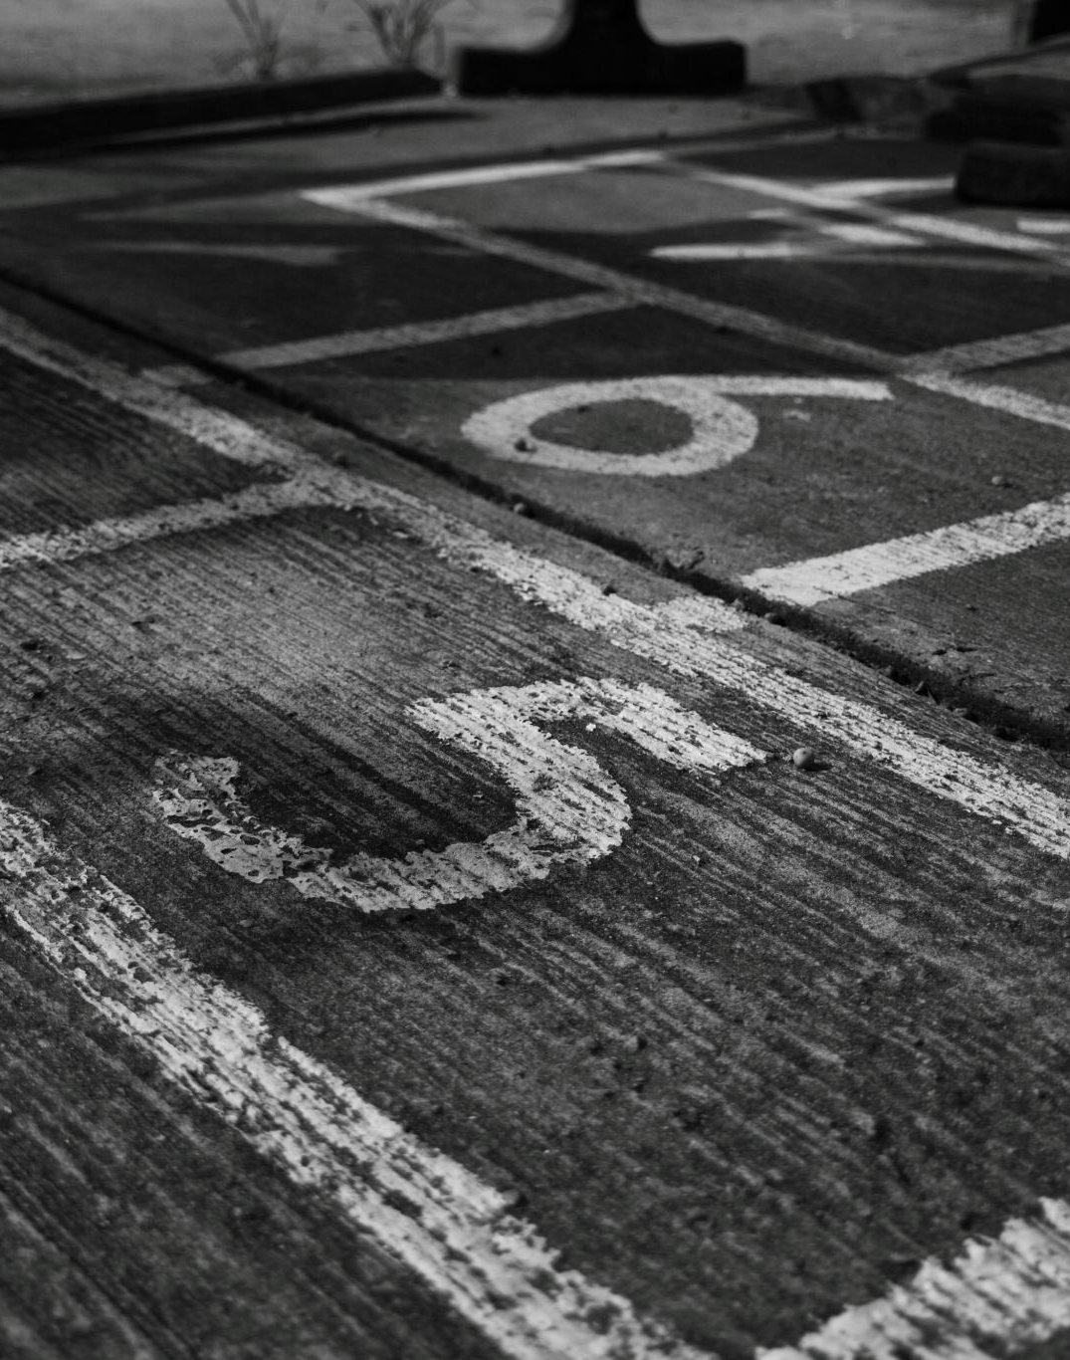
Factors to be considered
GPA
GRADES
ATTENDANCE

Slide 4
OBJECTIVE FUNCTION AND CONSTRAINTS
GPA
ATTENDENCE
GRADES
​Considering that GPA 3 is a good GPA, hence we have taken sum of GPA for each group should be >= 9.0
Considering that avg grade from discussion post should be at least 70% hence we have taken sum of grade from discussion post for each group should be >= 210.0
Considering that attendance should be at least 60% hence we have taken sum of attendance for each group should be >= 180.0

Slide 5
RESULTS
Group1 -
Student3, Student6, Student9.
Group2 –
Student5, Student8, Student10.
Group3 –
Student4, Student7, Student1.
Group4 –
Student2, Student11, Student12.

Slide 6


THANK YOU
ARAVIND
SHARIK
RAJIV

